Slide 1
Lexical Analysis
Lecture 03

Slide 2
Timeline
1930s: Turing Machine
1940’s & 1950s: Finite Automata,
FOTRAN and COBOL (Did not have formal definition)
1951: Stephen Cole Kleene invents regular expressions
Late 1950s: Chomsky Normal Form, Formal Grammar
S 🡪 LT (L= Letter and T= Tail piece of an identifier)
Where everything is a sentence in Chomsky Notation
1960: ALGOL was introduced with notations similar to Chomsky Notations to define what is a legal program
<identifier>::=<letter><tail>
(::= is backus-naur form or simply BFN it similar to XML, isn’t it ?)
1969: S. Cook, extended Turing study, traceable and intractable (NP- hard problem)

Slide 3
Example or Regular Expression / Regular Definition:
Regular Expression for numbers
digit → 0|1|…|9 digits → digit digit*
optional_fraction → .digits|ε optional_exponent → ( E (+|-| ε) digits ) | ε
num → digits optional_fraction optional_exponent
Using shorthands: digit → 0|1|…|9 digits → digit⁺
optional_fraction → (.digits)? optional_exponent → ( E (+|-| ε) digits ) ?
num → digits optional_fraction optional_exponent

Slide 4
Transition Diagram
A stylized flowchart produced intermediately in the construction of lexical analyzer
Depicts the actions take place in lexical analyzer
states: positions in a transition diagram
edges: arrows connecting the states
start state: initial state of transition diagram
accepting state: token recognized
action: (optional) associated with a state that is executed when the state is entered
start > =
0 1
2
other
*
3

Slide 5
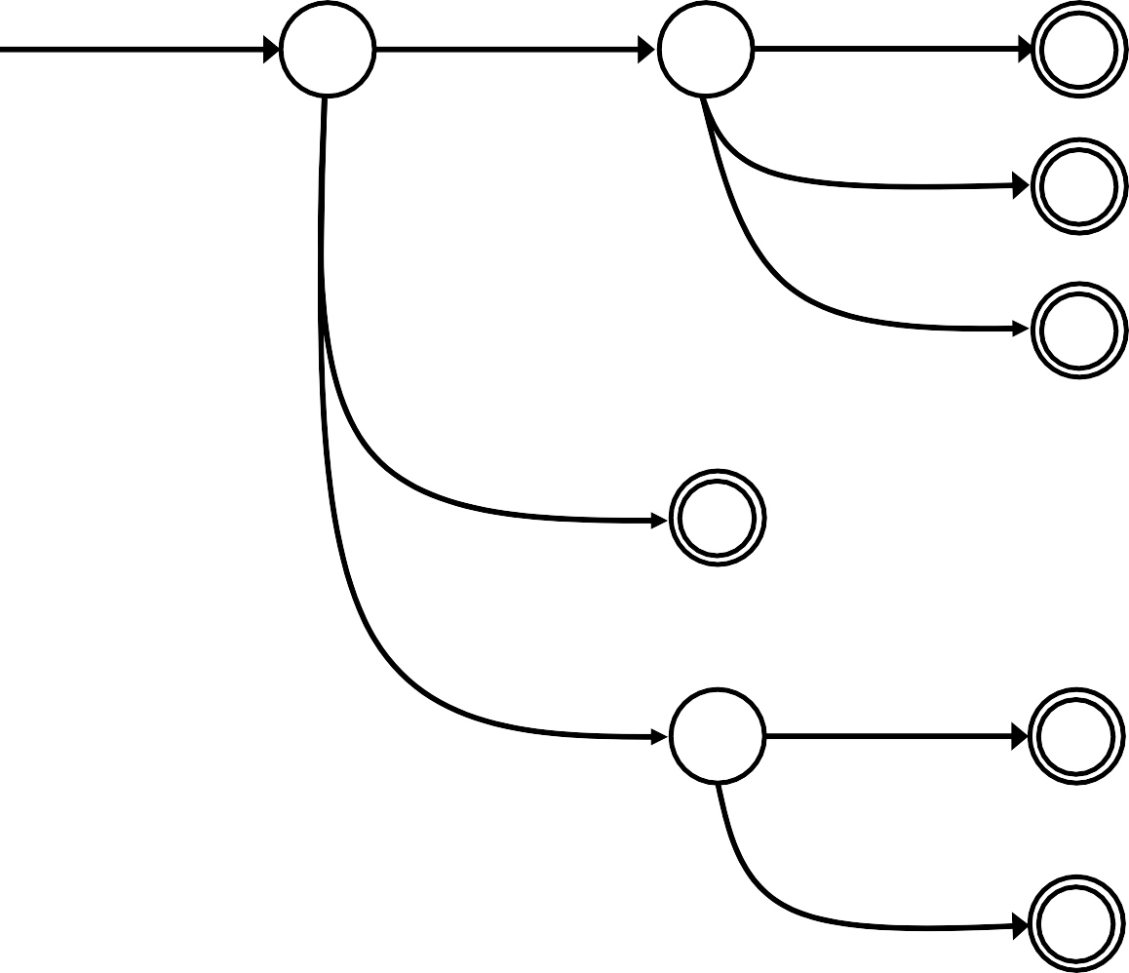
Example
< | > | <= | >= | = | <>
Transition diagram for token relop
start <
=
0 1
2
Return (relop, LE)
>
3
Return (relop, NE)
other
*
4
Return (relop, LT)
=
5
Return (relop, EQ)
>
=
Return (relop, GE)
6
7
other
*
₈ Return (relop, GT)

Slide 6
Transition diagram for Reserved Word or Identifier
Letter or digit
start
letter
other
*
9
10
11
Return (gettoken(), install_id())

Slide 7
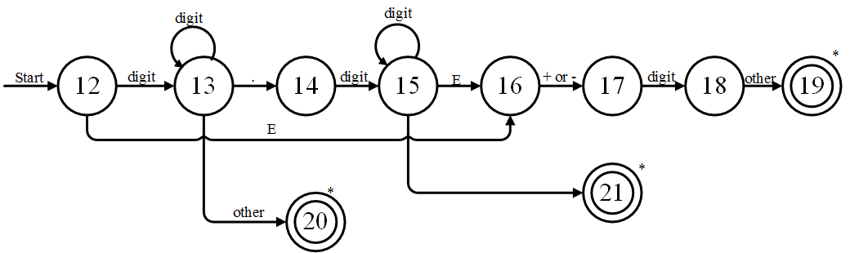
Transition Diagram for Unsigned Numbers

Slide 8
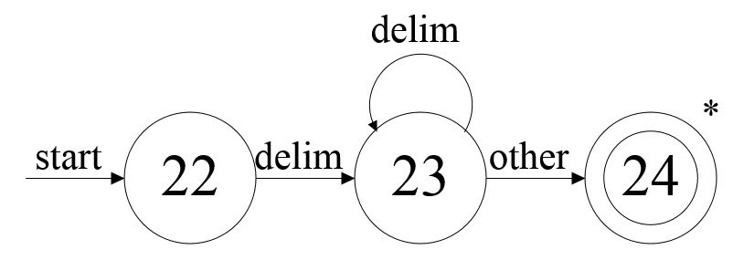
Transition Diagram for Whitespace

Slide 9
Capturing Multiple Tokens
Capturing keyword “begin”
start
b e g i
n WS
WS – white space A – alphabetic
AN – alphanumeric
Capturing variable names
start
A WS
AN
What if both need to happen at the same time?

Slide 10
Capturing Multiple Tokens
start b
e
g
i
n WS
A-b
AN
WS – white space A – alphabetic
AN – alphanumeric
AN
WS
Machine is much more complicated – just for these two tokens!

Slide 11
Architecture of a Tansition Diagram Based Lexical Analyzer
TOKEN getRelop() {
TOKEN retToken = new(RELOP) ;
while(1) { /* repeat character processing until
a return or failure occurs */
switch(state) {
case 0:
c = nextChar();
if(c =='<')state=1;
elseif(c =='=')state=5;
else if ( c == '>' ) state = 6;
/* lexeme is not a relop */
else fail() ;
break;
case 1: ...
...
case 8:
retract();
retToken.attribute = GT;
return(retToken);
} // end switch
} // end while
}

Slide 12
Implementing a Transition Diagram
Systematic approach for all transition diagrams
– Program size ∝ number of states and edges
We try each diagram and when we fail then we go to try the next diagram
Transition diagram for WS should be placed at the beginning rather at the end
– Generalize: frequently occurring tokens should come earlier

Slide 13
Finite State Automata (FSAs)
AKA “Finite State Machines”, “Finite Automata”, “FA”
Regular Expression = Specification
Finite Automata = Implementation
A finite automaton consists of
An input alphabet Σ
A set of states S
A start state n
A set of accepting states F ⊆ S
A set of transitions state 🡪 state
Two types
Deterministic (DFA)
Non-deterministic (NFA)
input

Slide 14

Finite Automata
Transition
a
S_{1 🡪} S₂
Is read
In state s₁ on input “a” go to state s₂
If end of input
– If in accepting state => accept,
othewise => reject
If no transition possible => reject

Slide 15



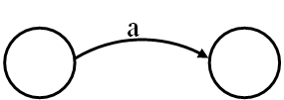
Finite Automata State Graphs
A state
The start state
An accepting state
A transition

Slide 16
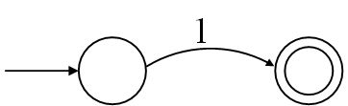
Example
A finite automaton that accepts only “1”
A finite automaton accepts a string if we can follow transitions labeled with the characters in the string from the start to some accepting state

Slide 17
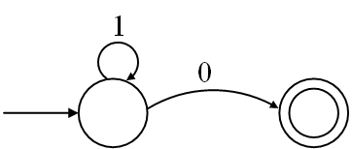
A finite automaton accepting any number of 1’s followed by a single 0
Alphabet: {0,1}
10
110
111110
111111110
1011 NOT ACCEPTED

Slide 18
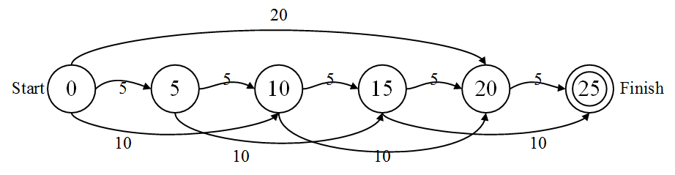

Real Life example: Vending Machine
A simple vending machine
If you give it 25 taka, it will vend you a bottle of coca cola.
This machine can only accept 5tk, 10tk and 20tk.
Consider it as a language to build up 25tk
It can happen as {5,5,5,5,5}, {10,10,5} and many more.
If you are on the 15 state, all the machine knows “It is on the 15 state”. If you ask the machine, “how did you get here?”, it will not be able to answer. It retains no memory of the coins it had to get to state 15.
These are machines with no need of memory
Electromechanical
Vending Machine

Slide 19
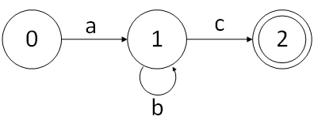
Regular Expression ab*c
Chomsky Type 3
S 🡪 aB
B 🡪 bB|c
Input strings: ac
abc
abbc
abbbc
….
Kleen’s Notation for this state diagram is: ab*c
where, b* means zero or more occurrences
Check how compact ab*c is than state diagram
The automaton diagram, the regular expression and the Comsky notation they all are equivalent

Slide 20
Deterministic Finite Automata
A deterministic finite automaton (DFA) is a mathematical model that consists of
A set of states S
S= {s₀, s₁, …., s_{N}}
A set of input symbols Σ
Σ = {a, b, …}
A transition function that maps state/symbol pairs to a state:
S x Σ 🡪 S
A special state s₀ called the start state
A set of states F (subset of S) of final states
•
INPUT: string OUTPUT: yes or no

Slide 21
DFA Execution
DFA(int start_state) {
state current = start_state; input_element = next_token(); while (input to be processed) {
current = transition(current,table[input_element]) if current is an error state return No; input_element = next_token();
}
if current is a final state return Yes; else return No;
}

Slide 22
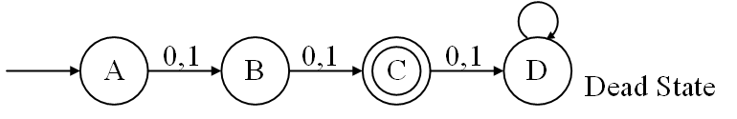
DFA Example
Construct a DFA that accepts set of all strings over {0,1} of length 2
Input String: 00
Input String: 10
Input String: 001

Slide 23
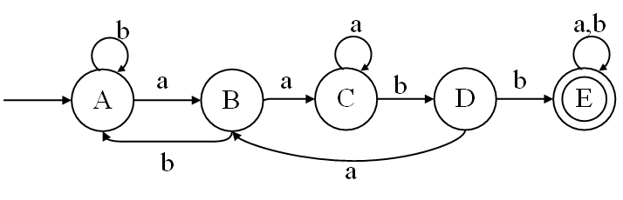
DFA Example
Construct a DFA that accepts any string over {a,b} that does not contain the string aabb in it
Alphabet {0,1}
Let us try to design a simpler problem by constructing a DFA that accepts all strings over {a,b} that contains the string aabb in it
This is the simplified DFA accepting all the string aabb

Slide 24
DFA Example
To construct a DFA that accepts any string over {a,b} that does not contain the string aabb in it we need to flip the simplified DFA which accepts aabb
Alphabet {0,1}
Let us try to design a simpler problem by constructing a DFA that accepts all strings over {a,b} that contains the string aabb in it
It means making the final state non-final and non-final state final

Slide 25
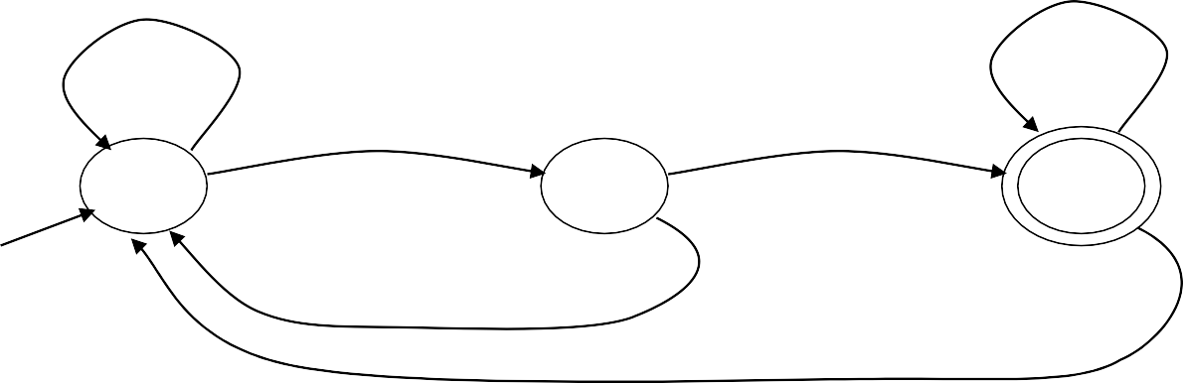
Another DFA Example
Alphabet {0,1}
What language does this recognize?
1
0
0
0
1
1

Slide 26
Solution
Alphabet {0,1}
What language does this recognize?
1
0
0
0
1
1
00
000
111100
1111001100
All strings terminated by at least two zeros
Regular Expression:
1*(0|1)*00
(0|1)*000*

Slide 27
A Different Example
Alphabet still { 0, 1 }
The operation of the automaton is not completely defined by the input
– On input “11” the automaton could be in either state
This leads to Non-Determinism. It might seem like it is not correct, but this defines a new type of finite automata called Non-Deterministic Finite Automata
In NFA, multiple transition will be possible from one state based on the same input symbol
1
1

Slide 28
Epsilon Moves
Another kind of transition: ε-moves
Machine can move from state A to state B without reading input
ε
A
B

Slide 29
Nondeterministic Finite Automata (NFA)
In NFA, given the current state there could be multiple states
The next state may be chosen random
It can choose empty input (Epsilon moves)
All the next state may be chosen in parallel

Slide 30
Deterministic and Nondeterministic Automata
Deterministic Finite Automata (DFA)
One transition per input per state
No ε-moves
Nondeterministic Finite Automata (NFA)
Can have multiple transitions for one input in a given state
Can have ε-moves
Finite automata have finite memory
Need only to encode the current state

Slide 31
Execution of Finite Automata
A DFA can take only one path through the state graph
Completely determined by input.
From one state it cannot got to two different states from the same input symbol
NFAs can choose
Whether to make ε-moves
Which of multiple transitions for a single input to take

Slide 32
DFA vs NFA
Both DFA and NFA can recognize same set of languages (regular languages)
But – time-space trade space exists
DFAs are faster recognizers (easier to implement)
– Can be much bigger too..
– There are no choices to consider

Slide 33
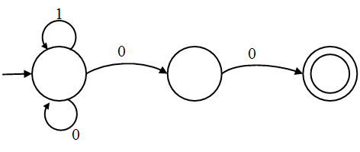
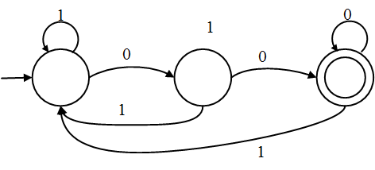
DFA vs NFA
For a given language the NFA can be simpler than the DFA
All binary strings ending with two zeros:
DFA can be exponentially larger than NFA
For the input string, the NFA can backtrack
1010100
NFA
DFA

Slide 34
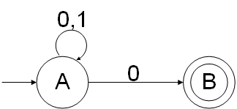
NFA Example 1
For a given language the NFA can be simpler than the DFA
All binary strings ending with one zero:
Transition Table:
An input alphabet Σ = {0, 1}
A set of states S = A, B
A start state n= A
A set of accepting states F ⊆ S = B
STATE | 0 | 1
A | A,B | A
B | ø | ø
Ø = Going nowhere

Slide 35
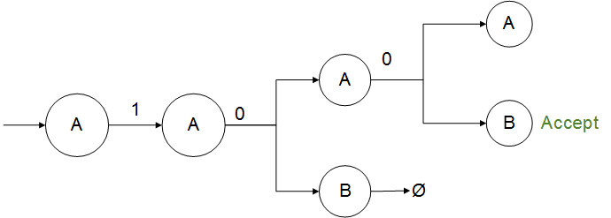
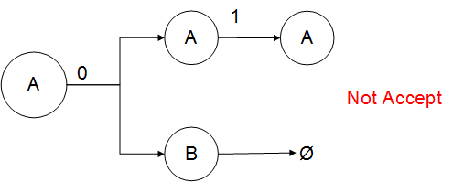
NFA Example 1

Slide 36
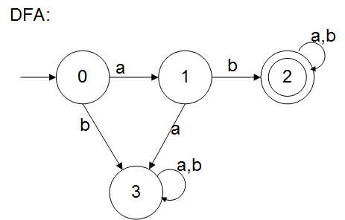
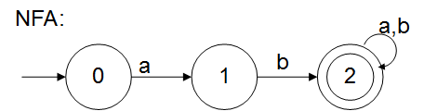
NFA Example 1
Design a NFA over an alphabet Σ = {a, b} such that every string accepted must start with ab

Slide 37
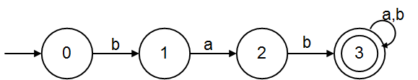
NFA Example 2
Design a NFA over an alphabet Σ = {a, b} such that every string accepted must start with bab

Slide 38

Example: NFA
Transition Table:
ε
start
STATE | a | b | ε
0 | 0,1 | 0 | 3
1 |  | 2
2 |  | 3
3
0
a
1
b
2
b
3
a,b
S = { 0,1,2,3} S₀ = 0
Σ = {a,b} F = {3}

Slide 39
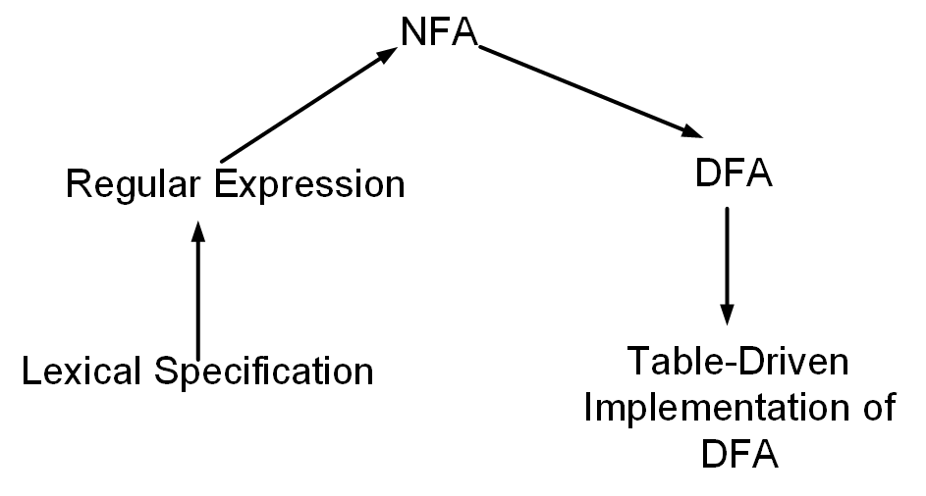
Regular Expression to Finite Automata
High Level Sketch:

Slide 40
Relation between RE, NFA and DFA
There is an algorithm for converting any RE into an NFA.
There is an algorithm for converting any NFA to a DFA.
There is an algorithm for converting any DFA to a RE.
These facts tell us that REs, NFAs and DFAs have equivalent expressive power.
All three describe the class of regular languages.

Slide 41
Converting Regular Expressions to NFAs
Thompson’s Construction
The regular expressions over finite Σ are the strings over the alphabet Σ + { ), (, |, *} such that:
{ } (empty set) is a regular expression for the empty set
Empty string ε is a regular expression denoting { ε }
start
ε
i f
a is a regular expression denoting {a } for any a in Σ
start
a
i f

Slide 42

Converting Regular Expressions to NFAs
If P and Q are regular expressions with NFAs N_{p}, N_{q}:
P | Q (union)
ε
N_{p}
ε
start
i
f
ε
N_{q}
ε
PQ (concatenation)
start
N_{p}
N_{q}
i
f

Slide 43
Converting Regular Expressions to NFAs
If Q is a regular expression with NFA N_{q}: Q* (closure)
ε
start
ε
N_{q}
ε
i
f
ε

Slide 44
Example (ab* | a*b)*
Starting with:
ab*
start
a
a*b
start
b
3
1
2
4
b
a
ab* | a*b
1
a ₂
ε
ε
start
5
ε
b
6
b
ε
3
4
a

Slide 45
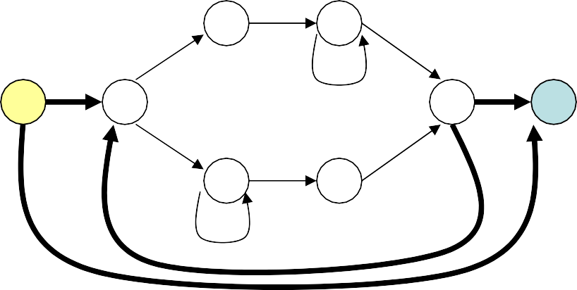
Example (ab* | a*b)*
ab* | a*b
1
a ₂
ε
ε
start
5
ε
b
6
b
ε
3
4
a
(ab* | a*b)*
1
a
2
ε
ε
start
ε
7
ε
ε
5
b
6
8
ε
ε
3
a
b
4
ε

Slide 46

Terminology: ε-closure
Defn: ε-closure(T) = T + all NFA states reachable from any state in T using only ε transitions.
1
b
2
b
a
b
5
ε-closure({1,2,5}) = {1,2,5}
ε-closure({4}) = {1,4}
ε-closure({3}) = {1,3,4}
ε-closure({3,5}) = {1,3,4,5}
ε
a
3
ε
4

Slide 47
Converting NFAs to DFAs (subset construction)
Idea: Each state in the new DFA will correspond to some set of states from the NFA. The DFA will be in state {s₀,s₁,…} after input if the NFA could be in any of these states for the same input.
Input: NFA N with state set S_{N}, alphabet Σ, start state s_{N}, final states F_{N}, transition function T_{N}: S_{N} x {Σ U ε} 🡪 S_{N}
Output: DFA D with state set S_{D}, alphabet Σ, start state s_{D} = ε-closure(s_{N}), final states F_{D}, transition function
T_{D}: S_{D} x Σ 🡪 S_{D}

Slide 48
Algorithm: Computation of ε-closure
push all states a ∈ T onto stack STK
initialize: ε-closure(T) = T
while STK is not empty do begin
pop t, the top element, off STK
for each stat u with and edge from t to u labeled ε do begin if u is not in ε-closure(T) do begin
add u to ε-closure(T) push u onto STK
end if end for
end while

Slide 49
Algorithm: Subset Construction
s_{D} = ε-closure(s_{N})
S_{D} = {s_{D}} (unmarked)
while there is some unmarked state R in S_{D}
mark state R for all a in Σ do
s = ε-closure(Τ_{Ν}(R,a));
if s not already in S_{D} then add it (unmarked) T_{D}(R,a) = s;
end for end while
F_{D} = any element of S_{D} that contains a state in F_{N}
-- create start state for DFA

Slide 50
Example 1: Subset Construction
NFA N with
State set S = {1,2,3,4,5},
NFA
N
Alphabet Σ = {a,b}
Start state s_{N}=1,
Final states F_{N}={5},
Transition function T_{N}: S_{N} x {Σ ∪ ε} 🡪 S_{N}
start
1
ε
2
a,b
a
b
5
a,b
3
4
 | a | b | ε
1 | 3 | - | 2
2 | 5 | 5, 4 | -
3 | - | 4 | -
4 | 5 | 5 | -
5 | - | - | -
b

Slide 51
Example 1: Subset Construction
NFA
start
1,2
start
1
ε
2
a,b
a
b
5
a,b
3
b
4
 | a | b
{1,2}

Slide 52
Example 1: Subset Construction
NFA
start
b
1,2
4,5
start
1
ε
2
a
a,b
a
b
5
3,5
a,b
 | a | b
{1,2} | {3,5} | {4,5}
{3,5}
{4,5}
3
b
4

Slide 53
Example 1: Subset Construction
NFA
start
b
1,2
4,5
start
1
ε
2
a
a,b
b
3,5
b
4
a
5
a,b
 | a | b
{1,2} | {3,5} | {4,5}
{3,5} | - | {4}
{4,5}
{4}
3
b
4

Slide 54
Example 1: Subset Construction
NFA
start
b
a,b
1,2
4,5
5
start
1
ε
2
a
a,b
b
3,5
b
4
a
5
a,b
 | a | b
{1,2} | {3,5} | {4,5}
{3,5} | - | {4}
{4,5} | {5} | {5}
{4}
{5}
3
b
4

Slide 55
Example 1: Subset Construction
NFA
start
b
a,b
1,2
4,5
5
start
ε
a
a,b
1
2
a,b
b
3,5
b
4
a
5
a,b
 | a | b
{1,2} | {3,5} | {4,5}
{3,5} | - | {4}
{4,5} | {5} | {5}
{4} | {5} | {5}
{5} | - | -
3
b
4

Slide 56
Example 1: Subset Construction
start
b
a,b
1,2
4,5
5
NFA
a
a,b
start
ε
b
1
2
a,b
3,5
4
a
b
5
a,b
 | a | b
{1,2} | {3,5} | {4,5}
{3,5} | - | {4}
{4,5} | {5} | {5}
{4} | {5} | {5}
{5} | - | -
3
b
4
All final states since the NFA final state is included

Slide 57
Example 2: Subset Construction
NFA
start
b
1
2
b
a
ε b
5
a
3
ε
4

Slide 58



Example 2: Subset Construction
NFA
DFA
start
b
start
a
1
2
b
1
1,3,4
a
ε b
5
b
b
a
a
2
b
a
3
4
1,3,
4,5
ε
b
b
a
1,4,5

Slide 59


Example 3: Subset Construction
NFA
DFA
b
3
start
ε
b
start
1
2
a
5
1,2,4
ε
a
b
b
3
a
b
3,4
3,5
4
b
5
b
a
4
a

Slide 60
Converting DFAs to REs
Combine serial links by concatenation
Combine parallel links by alternation
Remove self-loops by Kleene closure
Select a node (other than initial or final) for removal. Replace it with a set of equivalent links whose path expressions correspond to the in and out links
Repeat steps 1-4 until the graph consists of a single link between the entry and exit nodes.

Slide 61
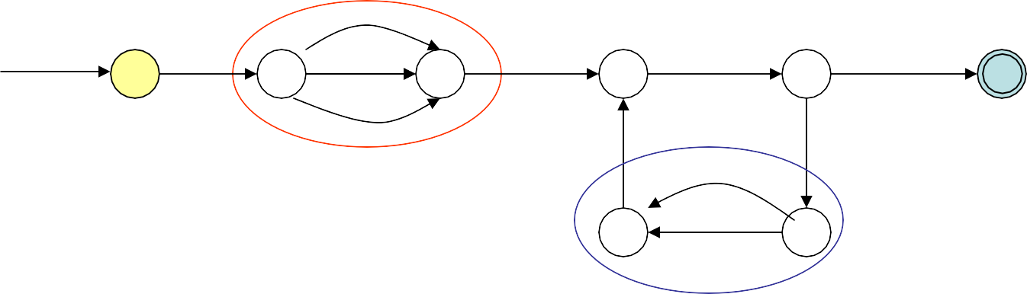
Example
a b
c
start
d
d
a
d
0
1
2
3
4
5
d
b
b
6
c
7
parallel edges become alternation
start
d
a|b|c
d
a
d
0
1
2
3
4
5
d
b
6
b|c
7

Slide 62
Example
start
d
a|b|c
d
a
d
0
1
2
3
4
5
d
b
6
b|c
7
serial edges become concatenation
start
d (a|b|c) d
a
d
0
3
4
5
b (b|c) d

Slide 63
Example
start
d (a|b|c) d
a
d
0
3
4
5
b (b|c) d
Find paths that can be “shortened”
start
0
d (a|b|c) d
a
d
3
4
5
b(b|c)da

Slide 64
Example
start
d (a|b|c) d
a
d
0
3
4
5
b(b|c)da
eliminate self-loops
start
d (a|b|c) d
a
(b(b|c)da)*d
4 5
0
3
serial edges become concatenation
start
d (a|b|c) d
a (b(b|c)da)*d
0
5

Slide 65
Describing Regular Languages
Generate all strings in the language
Generate only strings in the language
Try the following:
Strings of {a,b} that end with ‘abb’
Strings of {a,b} where every a is followed by at least one b

Slide 66
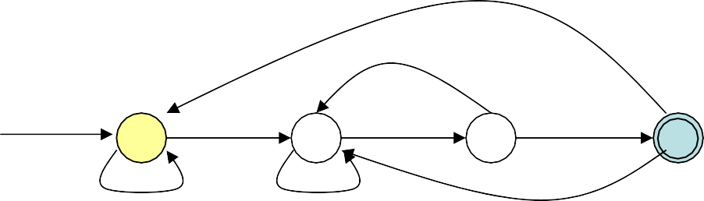
Strings of (a|b)* that end in abb
re: (a|b)*abb
start
a
b
b
0
1
2
3
a,b
NFA
a
b
start
a
b
b
0
1
2
3
b
a
a
DFA

Slide 67
Relationship among RE, NFA, DFA
The set of strings recognized by an NFA can be described by a Regular Expression.
The set of strings described by a Regular Expression can be recognized by an NFA.
The set of strings recognized by an DFA can be described by a Regular Expression.
The set of strings described by a Regular Expression can be recognized by an DFA.
DFAs, NFAs, and Regular Expressions all have the same “power”. They describe “Regular Sets” (“Regular Languages”)
The DFA may have a lot more states than the NFA. (May have exponentially as many states, but...)

Slide 68
Suggestions for writing NFA/DFA/RE
Typically, one of these formalisms is more natural for the problem. Start with that and convert if necessary.
In DFAs, each state typically captures some partial solution
Be sure that you include all relevant edges (ask – does every state have an outgoing transition for all alphabet symbols?)

Slide 69
Non-Regular Languages
Not all languages are regular”
The language ww where w=(a|b)*
Non-regular languages cannot be described using REs, NFAs and DFAs.

